Slide 1
Business Dashboard
Data Analysis &
Performance Improvement
Tax Compliance
Payroll Processing

Slide 2


Slide 3


Switch Your Accountant
Accountax

Slide 4
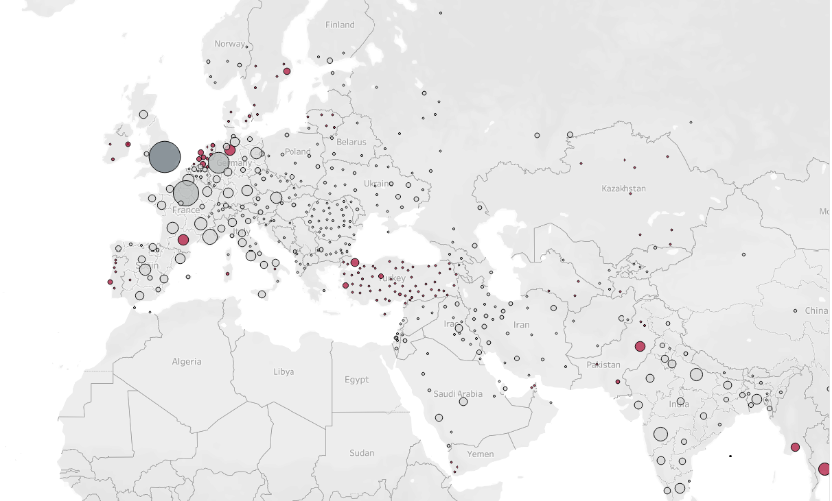
Management Performance Reporting
Data Analytics
Performance Improvement

Slide 5
International Finance Reporting Standards
IFRS

Slide 6
Part time CFO & Accountants
CFO
Accountant
Accountant

Slide 7
Tax Bill
Tax Compliance & Reporting
Audit
Tax Reporting
VAT
Digital Submission

Slide 8
Digital Transformation & Performance Improvement

Slide 9
Merger & Acquisition
Acquiring Business
Synergy
Accountax
Integration
Incorporating New Businesses

Slide 10
Audit & Controls
Issues and Findings

Slide 11
Recording
Processing
Payment

